Slide 1
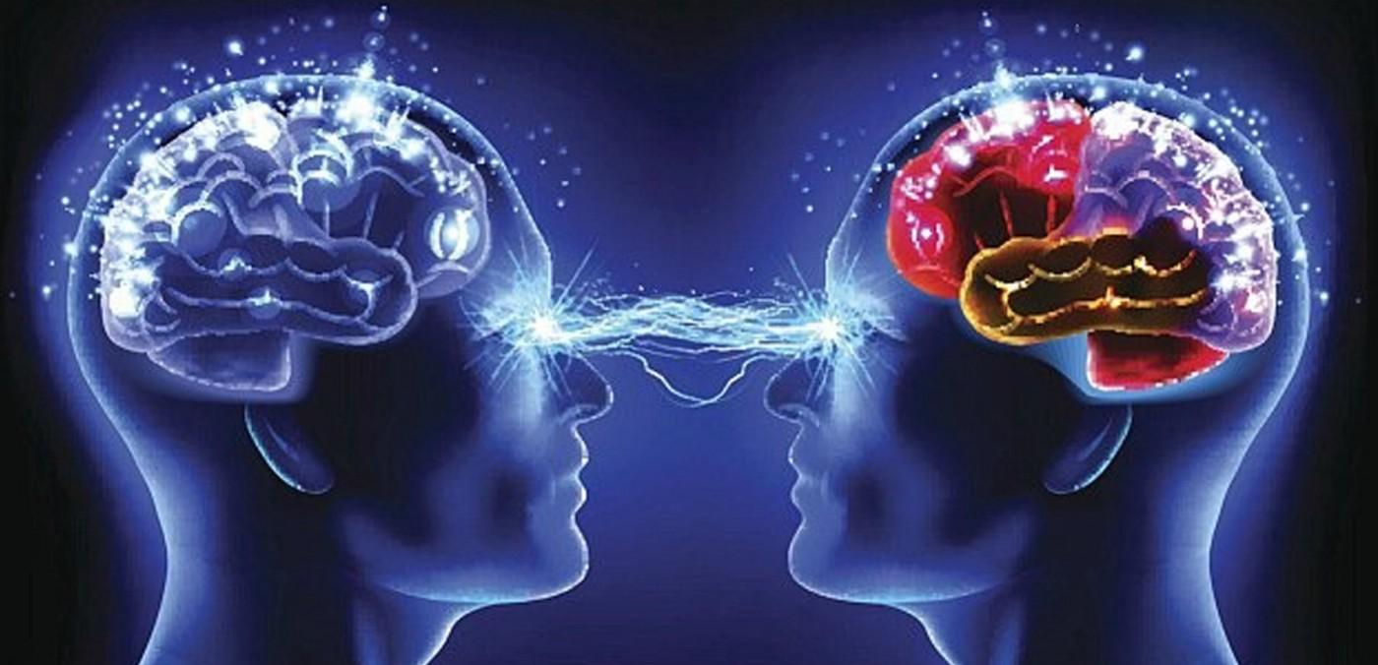
Why do people change their minds/behaviors over the time? Modelling of Complex Systems July 31, 2022 Majdal Hindi

Slide 2
Literature Research
Most researchers in social-personality psychology would agree that social processes and behavior are dynamical and change over time.(reference)
In general people stick to their beliefs but under the pressure of the new facts/ resources (ex. the influence of media) many of them give up and change their beliefs.(reference)
New types of connectivity’ between people appear to have an important influence on social processes.
The transmission from one option to another is a rational decision-making process whereby people weigh the costs and benefits of their transmission payoff (reference).
Mood can be considered a memory stochastic process; it is a flexible, dynamic process that has a 'short memory' both in healthy controls and euthymic patients with bipolar disorder. The results suggest that nonlinear measures can be applied to the study of mood disorders.(reference)

Slide 3
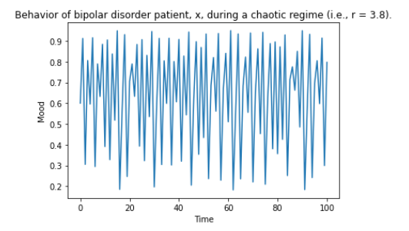
Chaotic behavior
Simple deterministic nonlinear systems produce extremely complex , unpredictable behavior.
It is sensitive dependence on initial conditions: knowing the initial conditions of any natural dynamical system with perfect precision is impossible, it is therefore equally impossible to predict the long-term behavior of such systems if they are chaotic.
Example: daily mood of an individual diagnosed with bipolar disorder.
Discrete dynamical equation= x ( t+1 ) = r * x ( t ) * (1 − x ( t ) )
x: represents the individual’s daily mood on a scale of 0 to 1:
1: perfectly positive mood
0: perfectly negative mood
r: represents the severity of the individual’s diagnosis on a scale of 0 to 4, with 4 corresponding to a severe diagnosis.

Slide 4
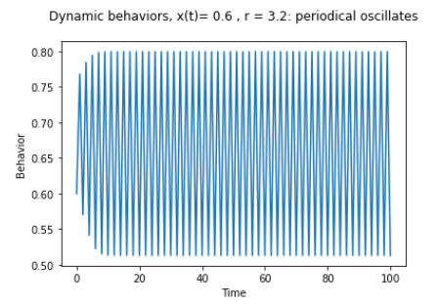
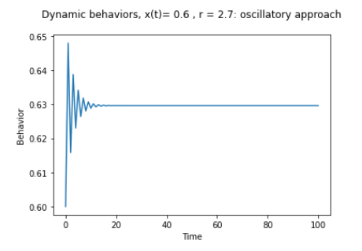
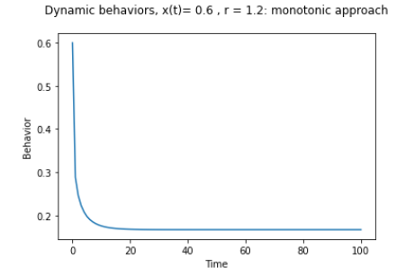
Dynamic behaviors

Slide 5
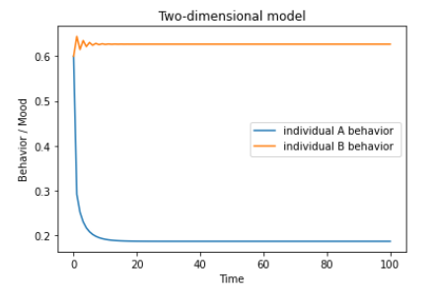
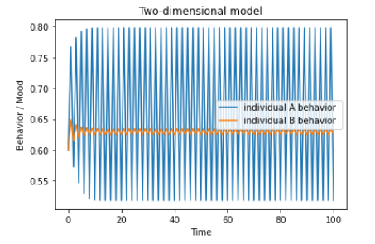
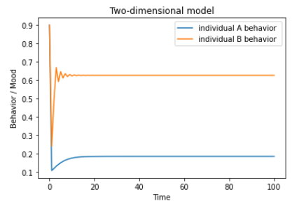
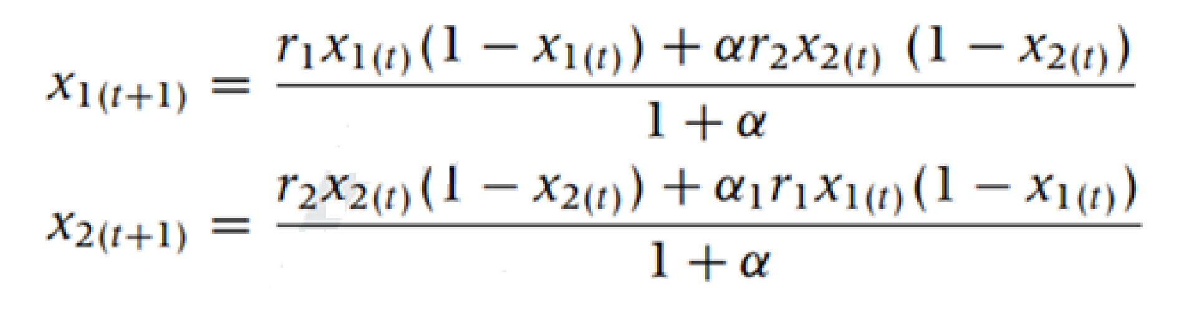
Interactional Behavior

Slide 6
Change behavior by influence/attraction
Example: someone favored one politician/football team, but today s/he prefers different one.
Decision depends on the payoff of each option.
Payoff is the interest of 'conversion' of adopters from one option to another. Based on:
The number of people adopting one option makes this option more attractive ( for some people means the opposite).
Attraction: Some beliefs could be more interesting for some people so they could adopt them even if they are a minority.
Social norms are not static so the attractiveness of specific beliefs can vary over time (reference)

Slide 7
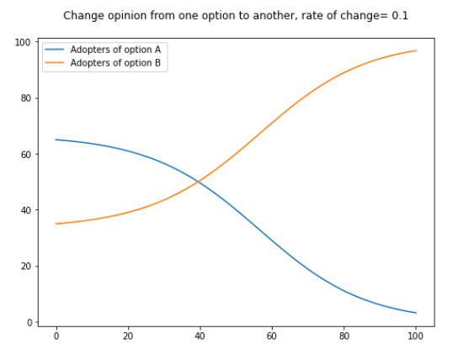
Simulation results
1. Each option has initial attractiveness ( feature strength)
2. By calculating the difference of the payoff between the two options, we can decide which option is more attractive.
4. We can update the attractiveness of each option to be changing over time. For example: stochastic normal distribution, Gamma distribution.
3. Alpha is a rate to control how strong the transmission from option A to option B and back.

Slide 8
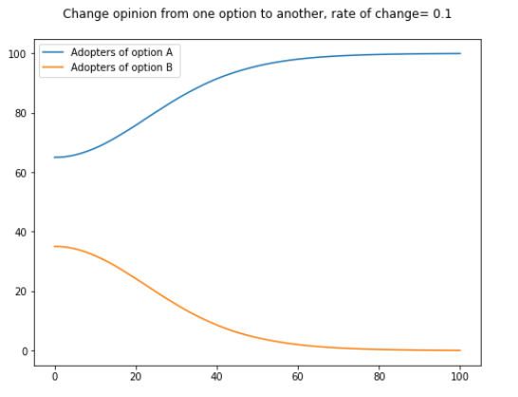
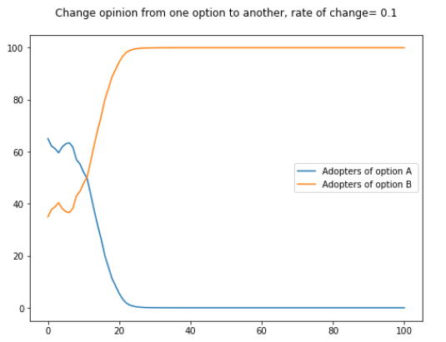
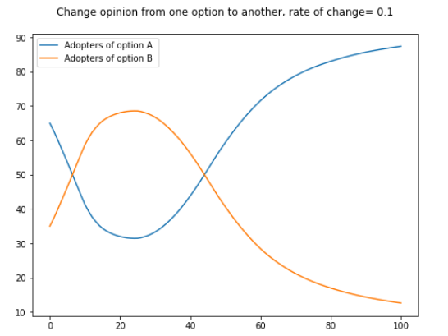
Different options for modelling attractiveness
Fixed Attractiveness
Gaussian Stochastic Attractiveness
Gamma Stochastic Attractiveness
Jupyter Notebook

Slide 9
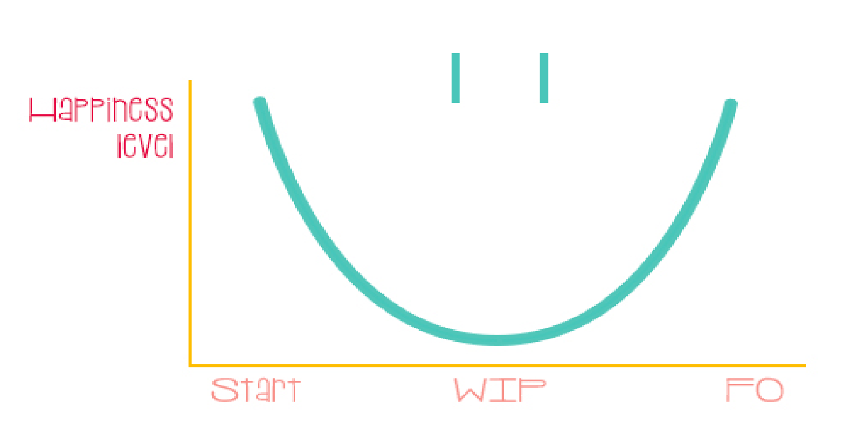
Holiday Mood Simulation

